Slide 1
Dynamic Programming

Slide 2
Overview
Morning
Programming task: Frozen lake
Markov Decision Process (MDP)
state, action, reward, goal
value function, q function
Policy evaluation
Afternoon
Policy improvement
Policy iteration
Value iteration
Temporal Difference learning (TD)

Slide 3
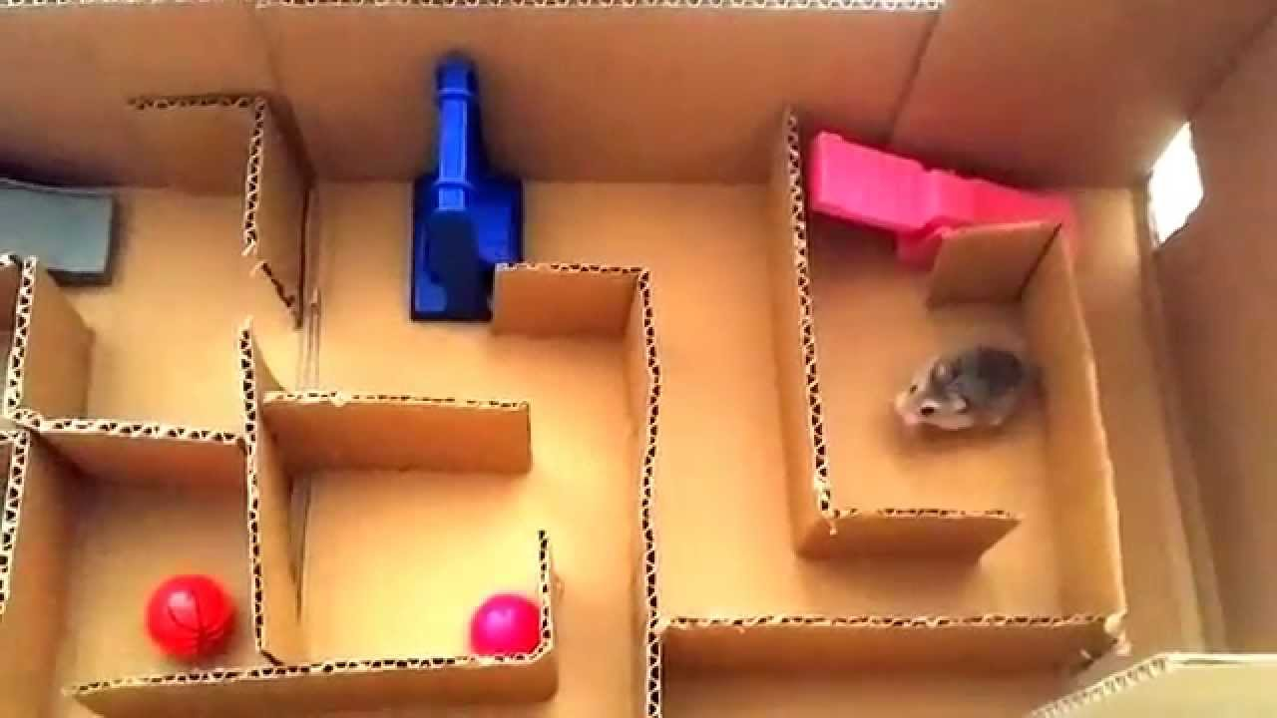

Slide 4
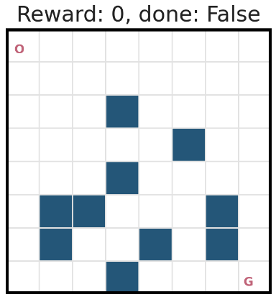
Frozen Lake
Reference:
https://github.com/udacity/deep-reinforcement-learning/blob/master/dynamic-programming/frozenlake.py

Slide 5
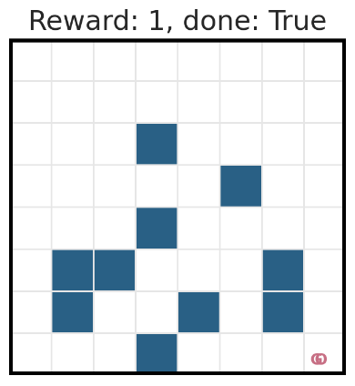
Frozen Lake
Reference:
https://github.com/udacity/deep-reinforcement-learning/blob/master/dynamic-programming/frozenlake.py

Slide 6
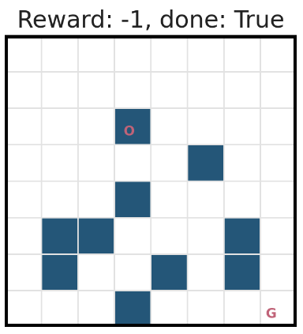
Frozen Lake
Reference:
https://github.com/udacity/deep-reinforcement-learning/blob/master/dynamic-programming/frozenlake.py

Slide 7

Markov decision process (MDP)
S_{t-1}
S_{t}
S_{t+1}
R_{t-1}
R_{t}
R_{t+1}
Why Markov property?
A_{t-1}
A_{t}
A_{t+1}

Slide 8
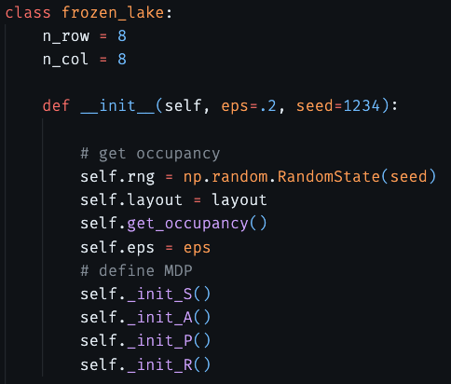
Markov decision process (MDP)

Slide 9
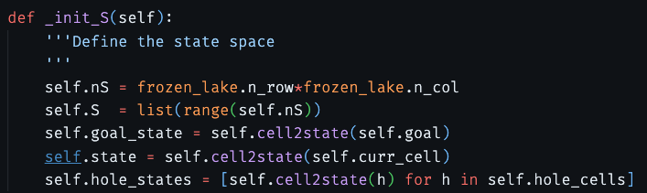
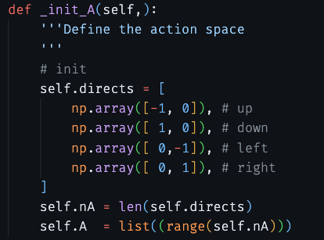
Markov decision process (MDP)

Slide 10

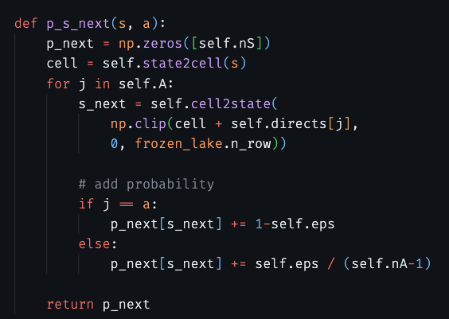
Markov decision process (MDP)

Slide 11

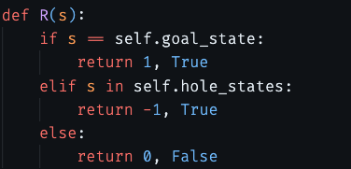
Markov decision process (MDP)

Slide 12
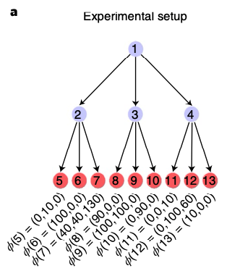
Markov decision process (MDP)

Slide 13
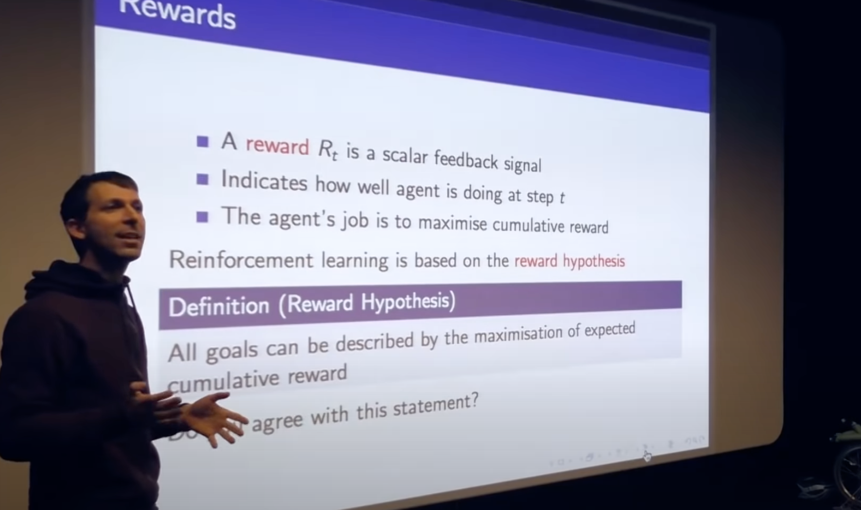
Reward hypothesis

Slide 14
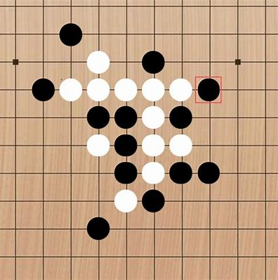

Slide 15
Reward hypothesis

Slide 16

Policy
A policy maps a state to a distribution of actions
S_{t-1}
S_{t}
S_{t+1}
R_{t-1}
R_{t}
R_{t+1}
A_{t-1}
A_{t}
A_{t+1}

Slide 17
Expected cumulative reward
S_{t-1}
S_{t}
S_{t+1}
R_{t-1}
R_{t}
R_{t+1}
A_{t-1}
A_{t}
A_{t+1}

Slide 18
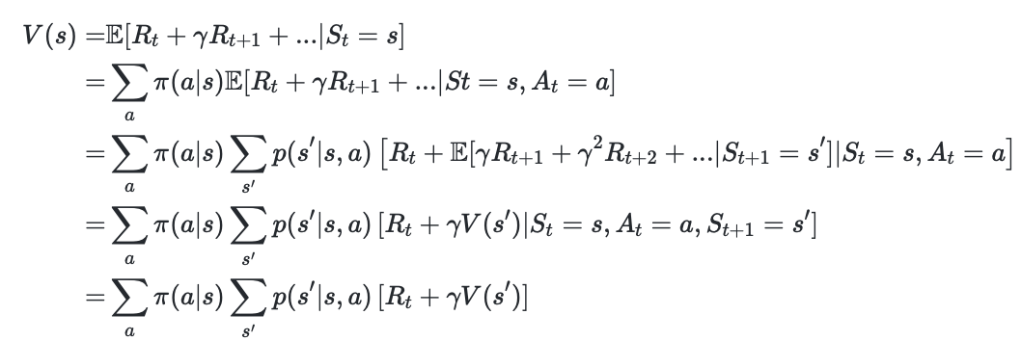
Expected cumulative reward
S_{t}=s

Slide 19
Expected cumulative reward
S_{t}=s
A_{t}

Slide 20
Expected cumulative reward
S_{t}=s
S_{t+1}
R_{t}
A_{t}

Slide 21
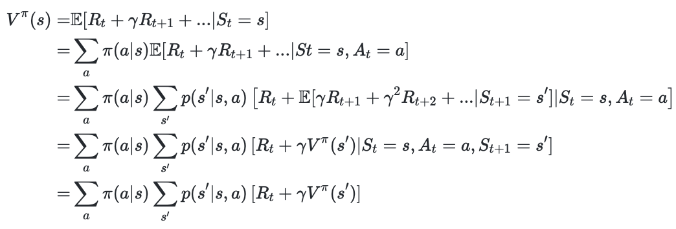
Expected cumulative reward
S_{t}=s
S_{t+1}
R_{t}
A_{t}

Slide 22
Value function & Bellman equation
S_{t}=s
S_{t+1}
R_{t}
A_{t}

Slide 23
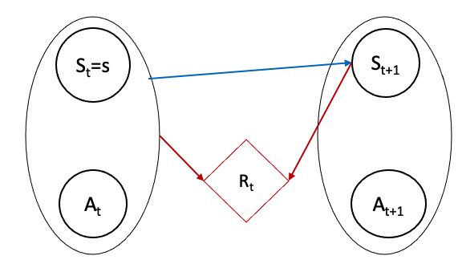
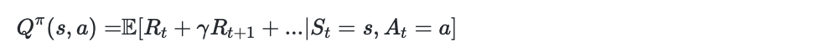
Q function: state-action value function
S_{t}=s
S_{t+1}
R_{t}
A_{t}

Slide 24
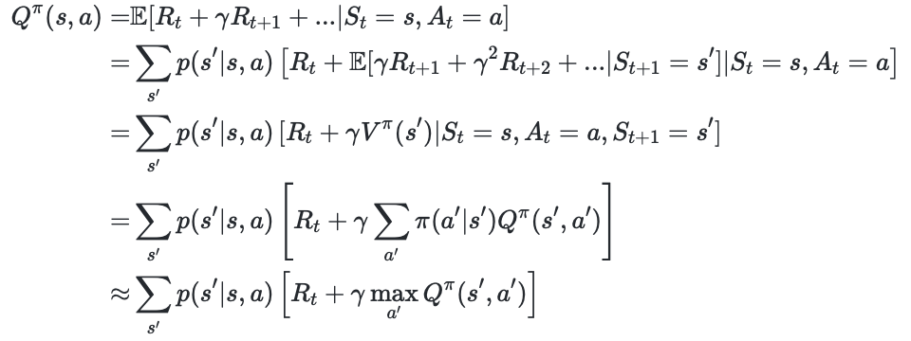
Q function: state-action value function
S_{t}=s
S_{t+1}
R_{t}
A_{t}

Slide 25
Q function: state-action value function
S_{t}=s
S_{t+1}
R_{t}
A_{t}

Slide 26
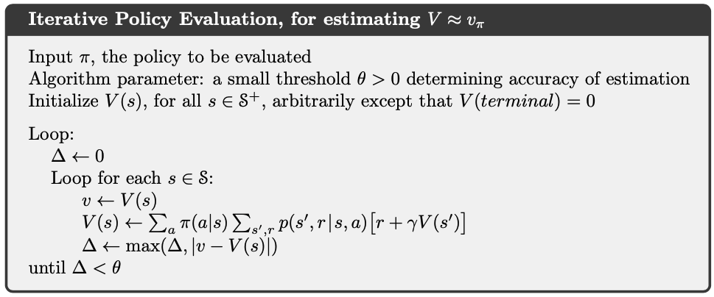

Dynamic programming: policy evaluation

Slide 27

Reward hypothesis

Slide 28
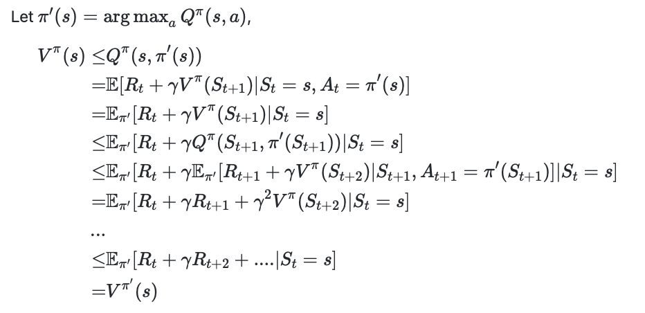
Policy improvement

Slide 29
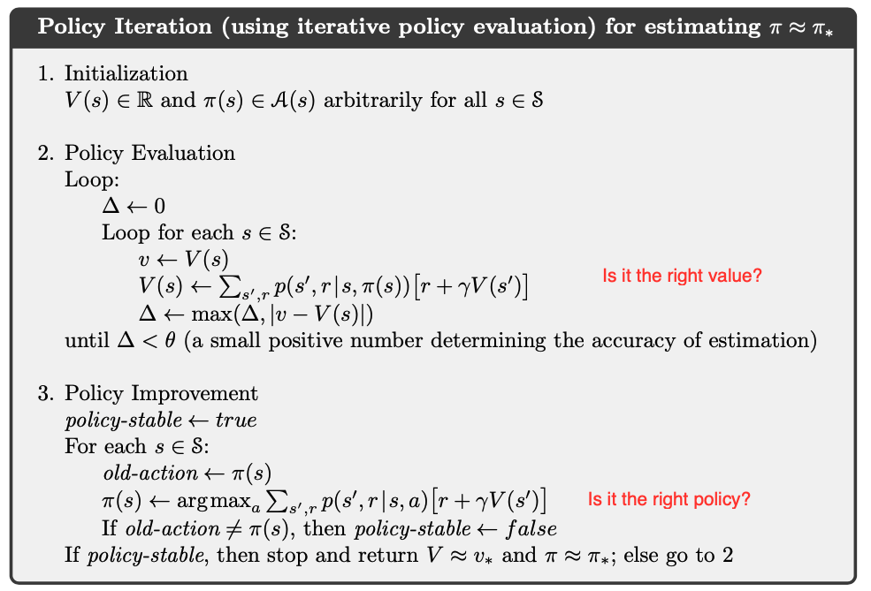
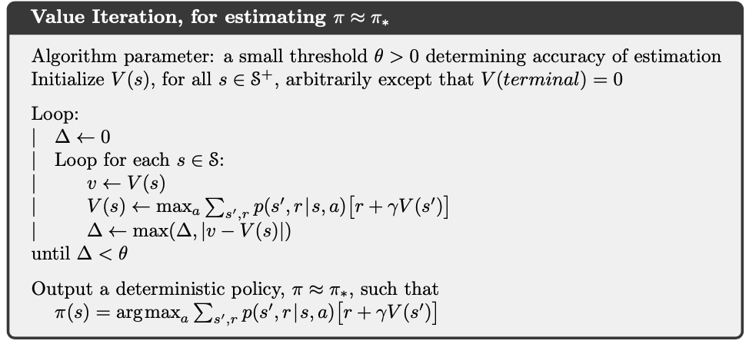


Policy improvement

Slide 30
Value iteration

Slide 31


From value to Q function

Slide 32
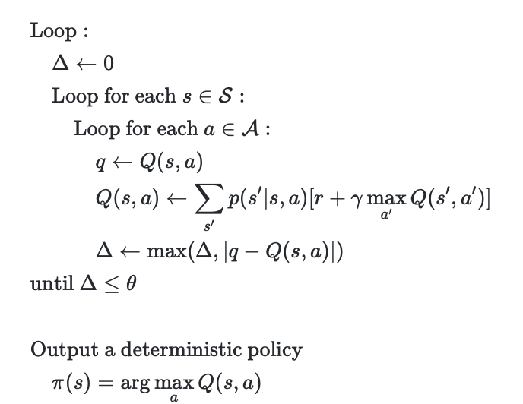
Q function Iteration

Slide 33
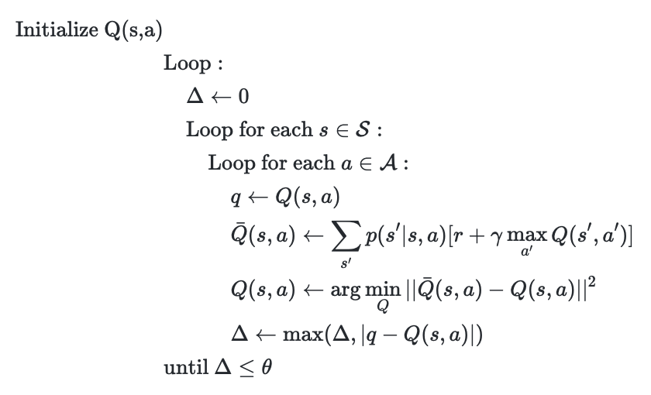
Another persepctive

Slide 34
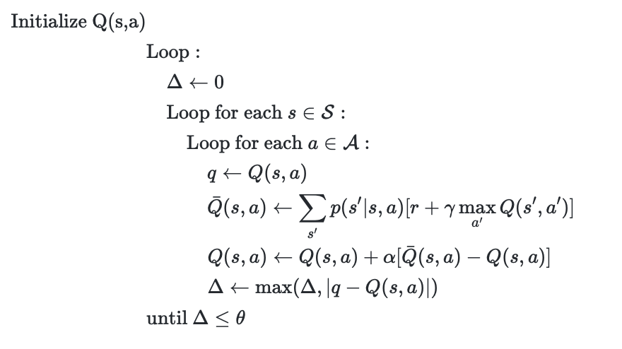
When estimation is not accurate

Slide 35
What’s wrong with dynamic programming
The state and action space can be huge
We do not always know the transition function and reward fucntion

Slide 36
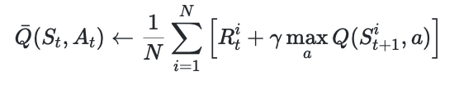
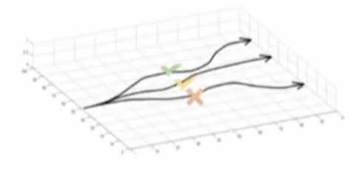
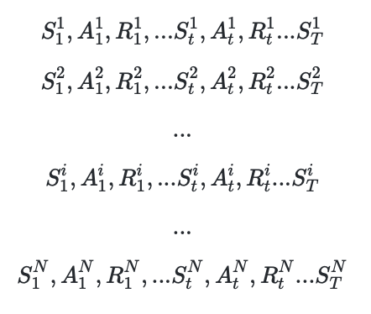
Sampling as a solution

Slide 37


Get one sample

Slide 38
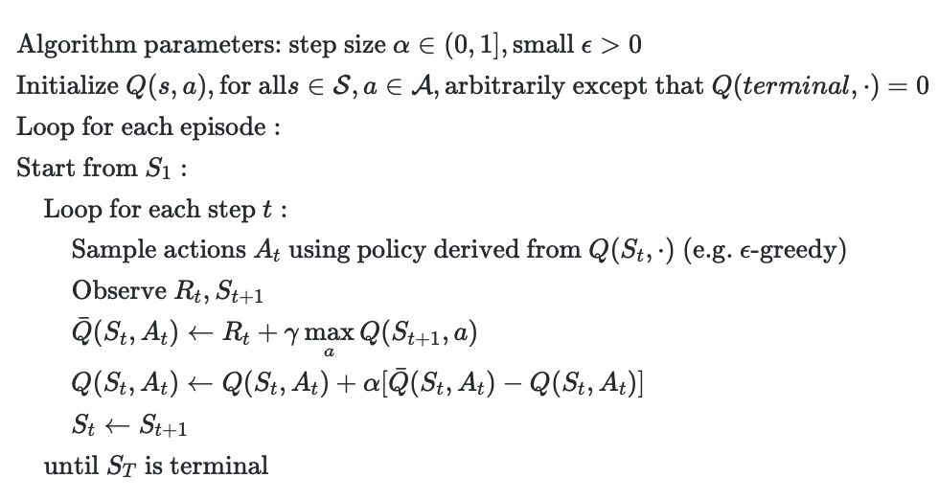
TD learning (Q learning)

